Slide 1

Lecture 1 INT 221- LARAVEL HOW TO INSTALL COMPOSER

Slide 2
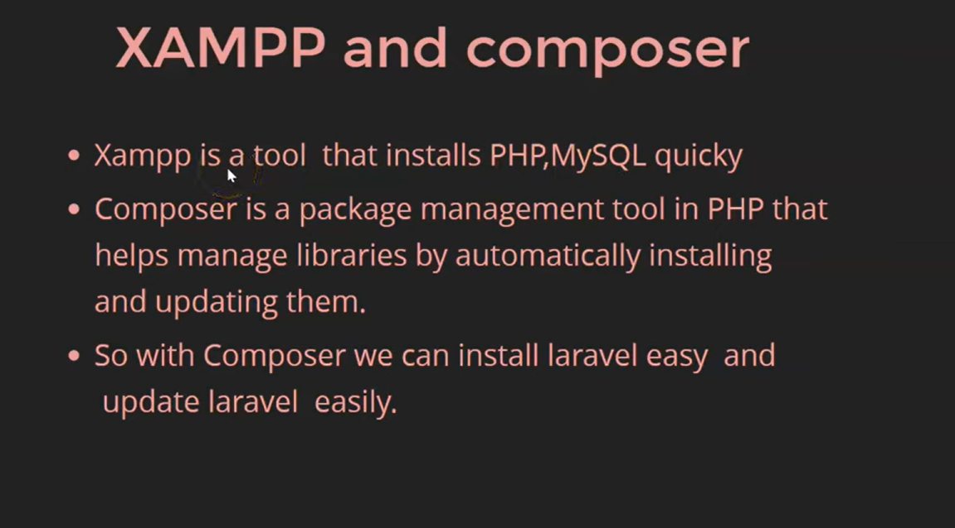
XAMPP and Composer

Slide 3
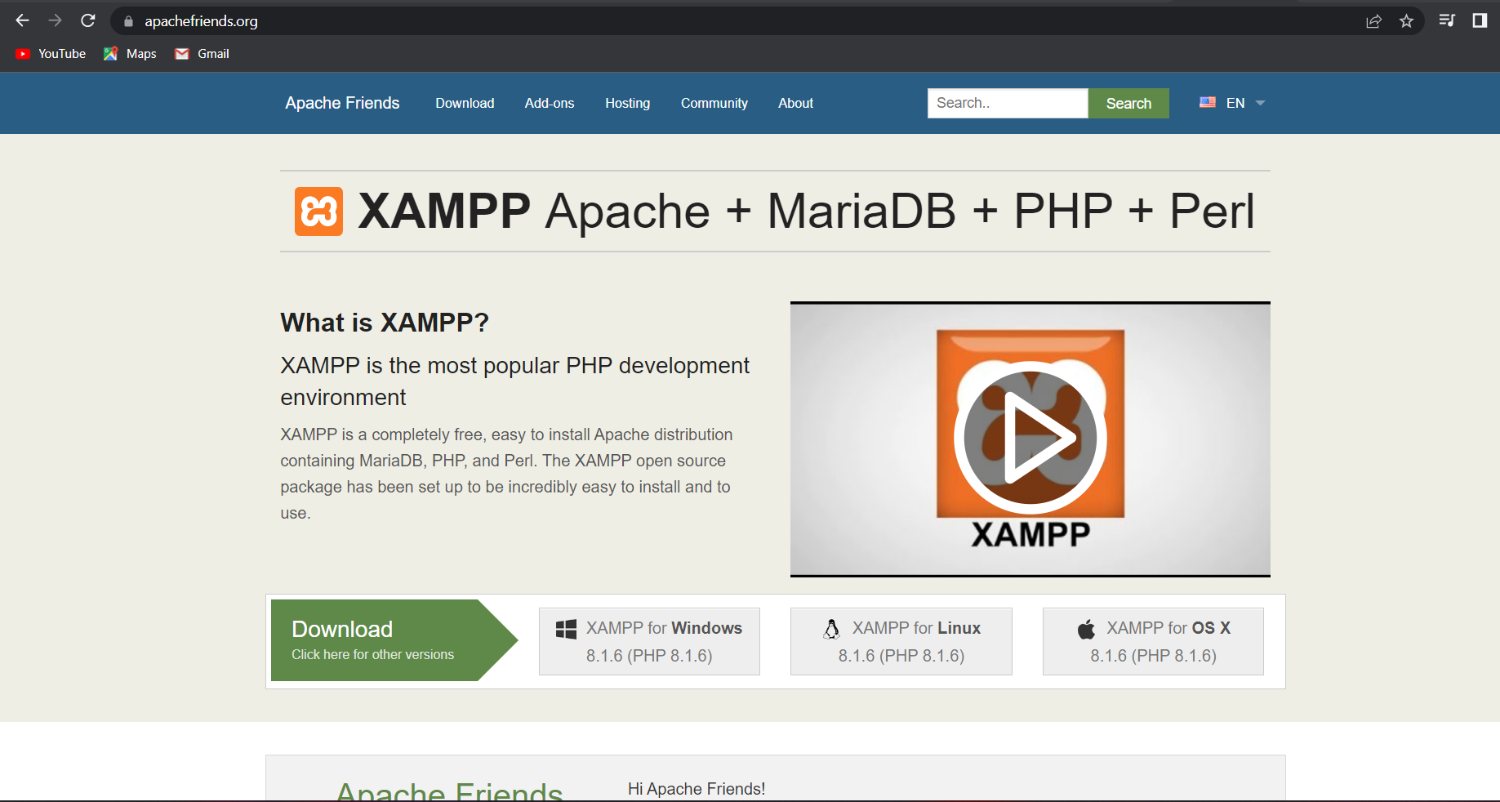
GO to apachefriends.org

Slide 4
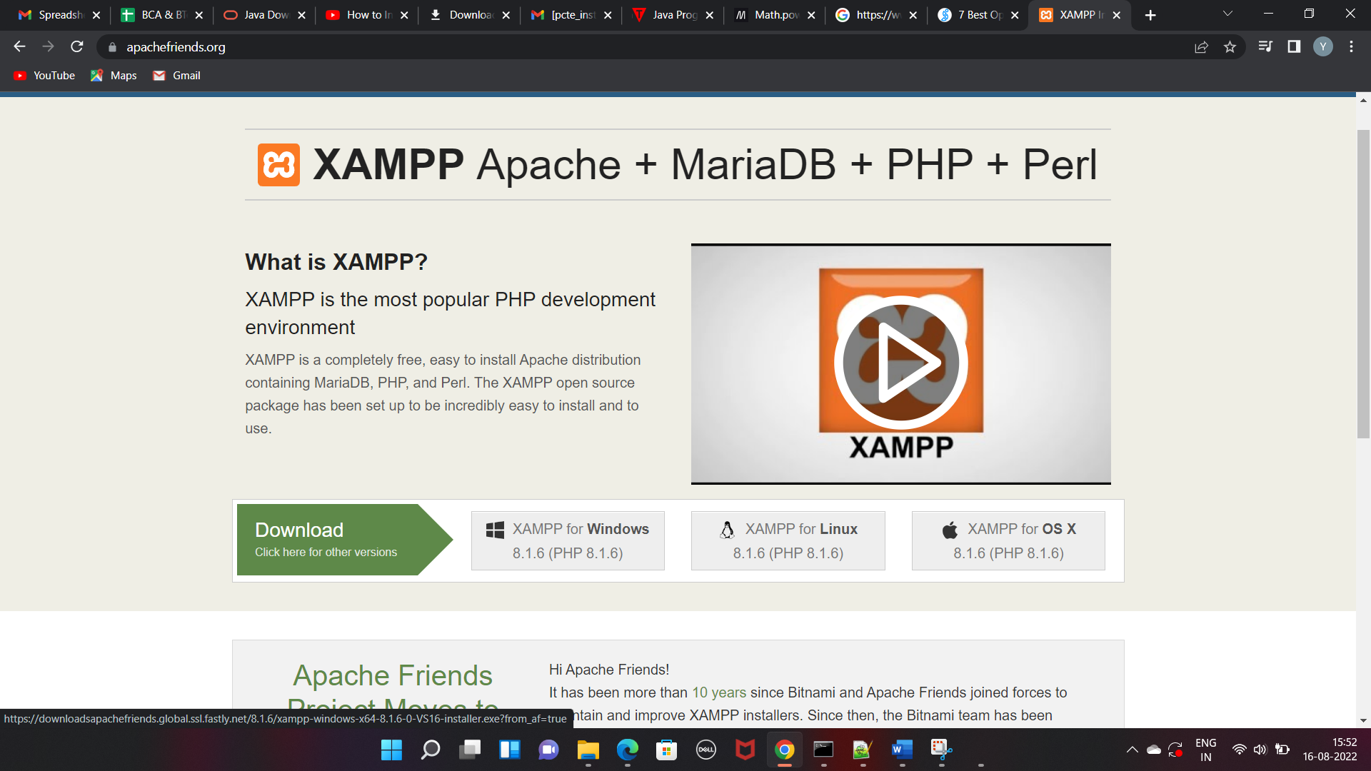
Go To XAMPP for Windows

Slide 5
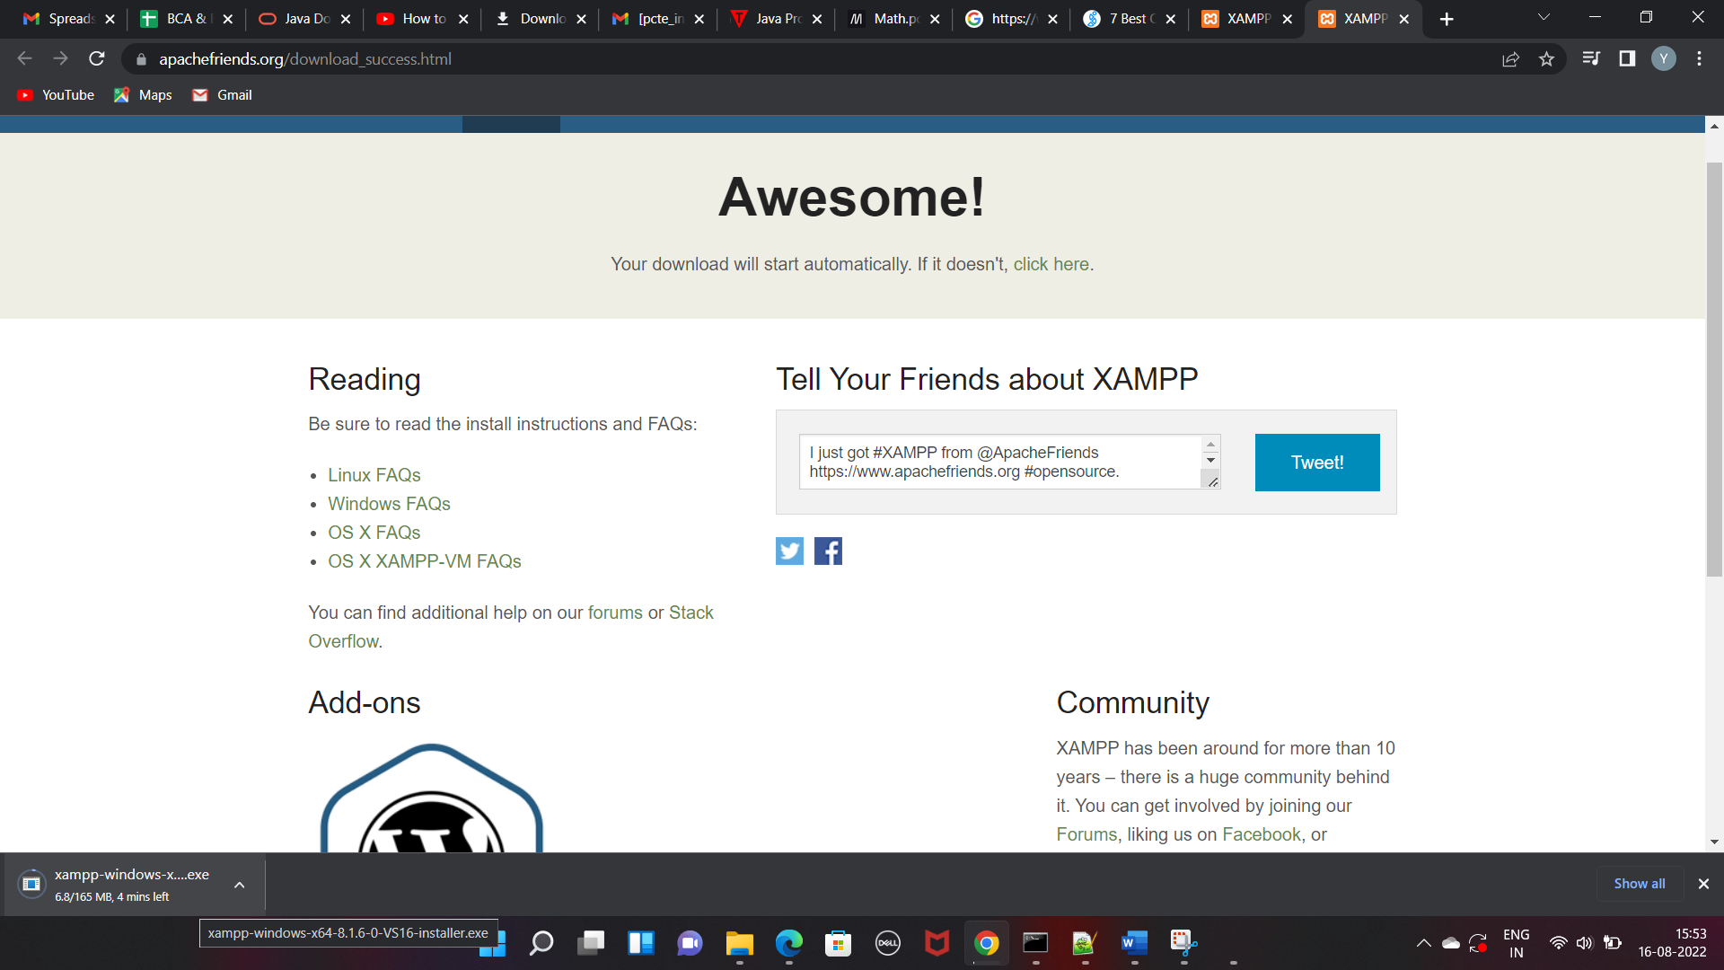
XAMPP will start downloading

Slide 6
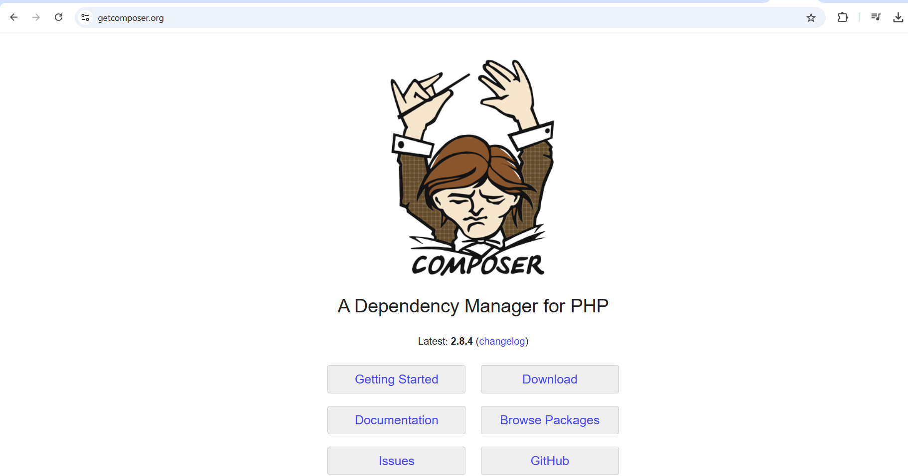
Go to getcomposer.org

Slide 7
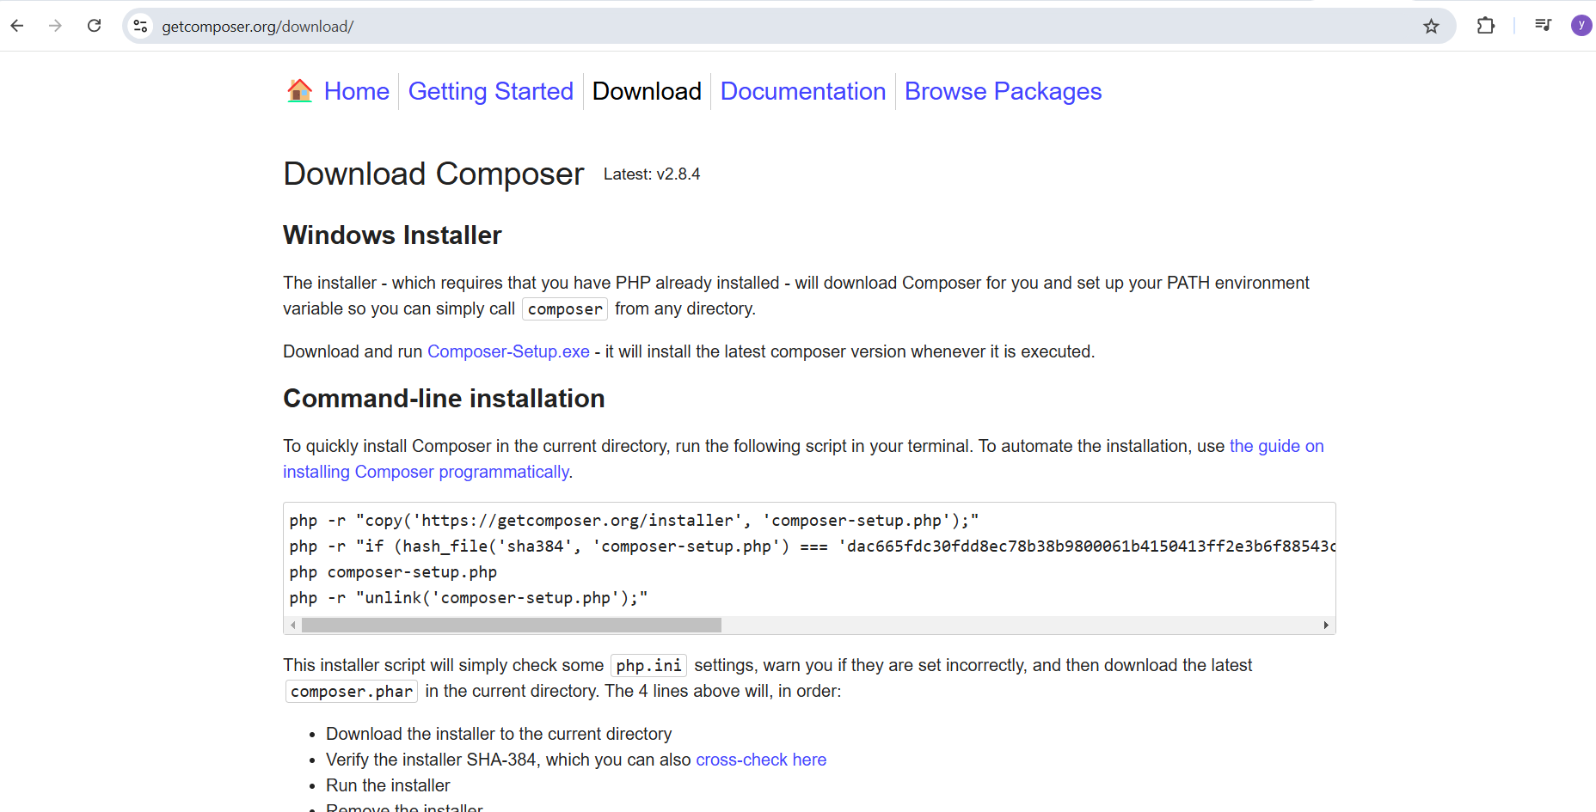
After clicking on Downloads run Composer-setup.exe file

Slide 8
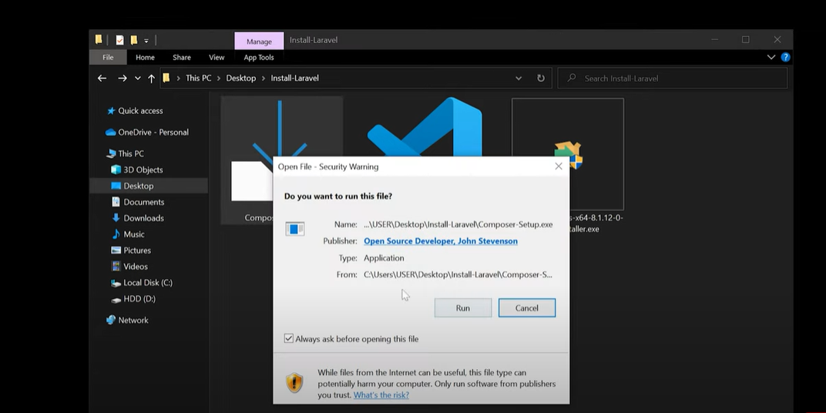
Click on Run

Slide 9
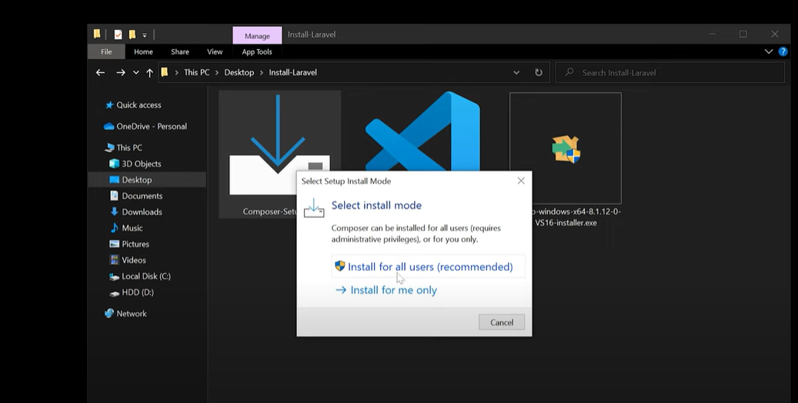
Click on Install for all users

Slide 10
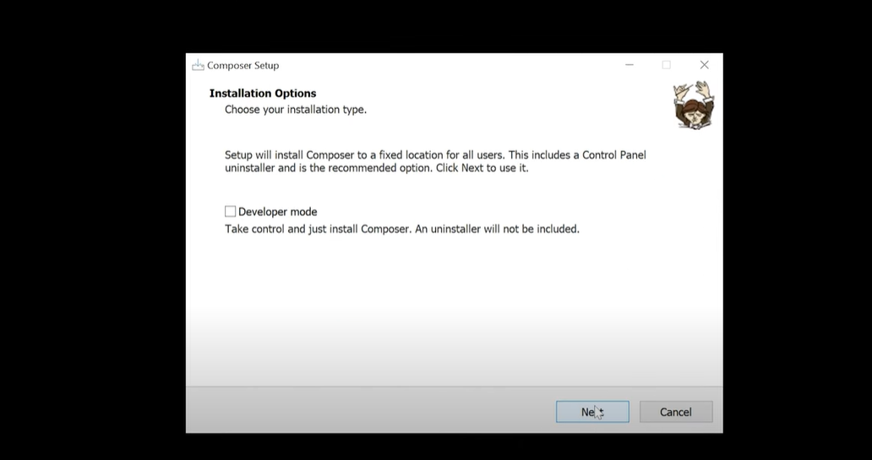
Click on Next

Slide 11
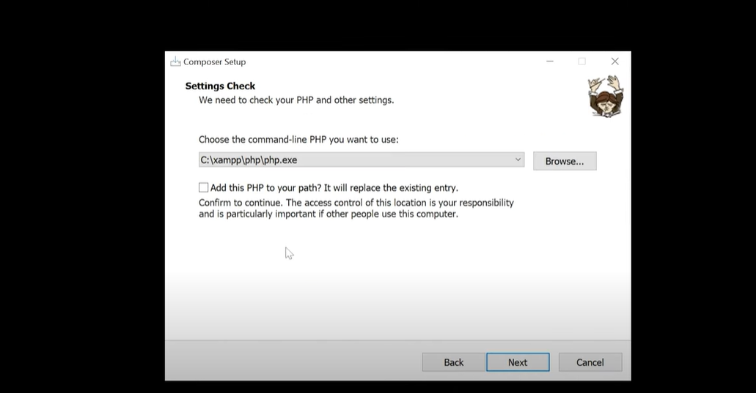
Click on Check Box and click on Next

Slide 12
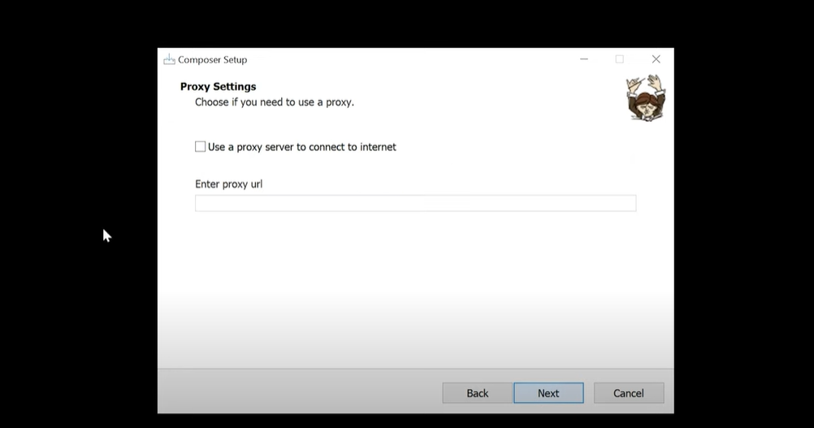
Click on Next

Slide 13
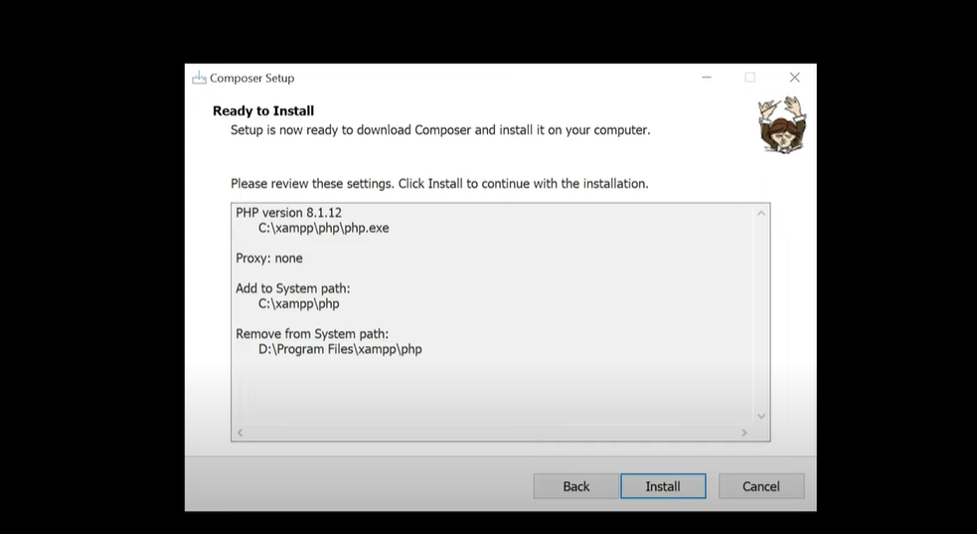
Click on Install

Slide 14
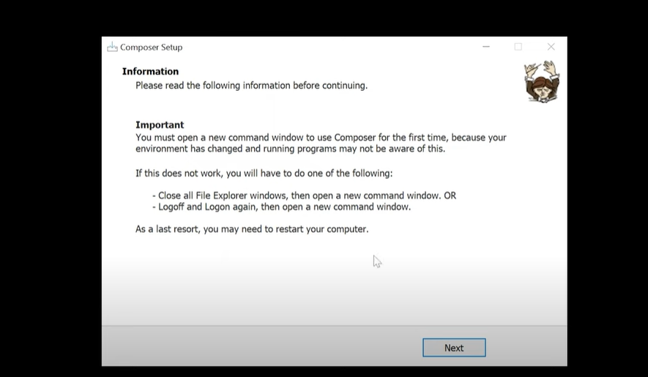
Click Next

Slide 15
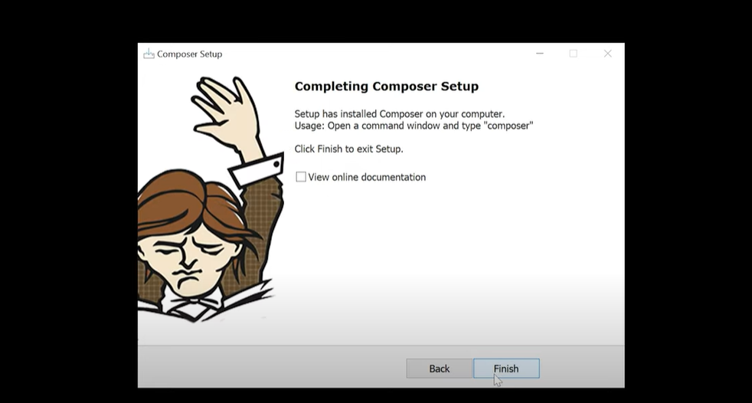
Click on Finish

Slide 16
Check PHP Version
php -v

Slide 17
Check Git Version
git --version

Slide 18
Check Composer Version
composer --version
Or
composer

Slide 19
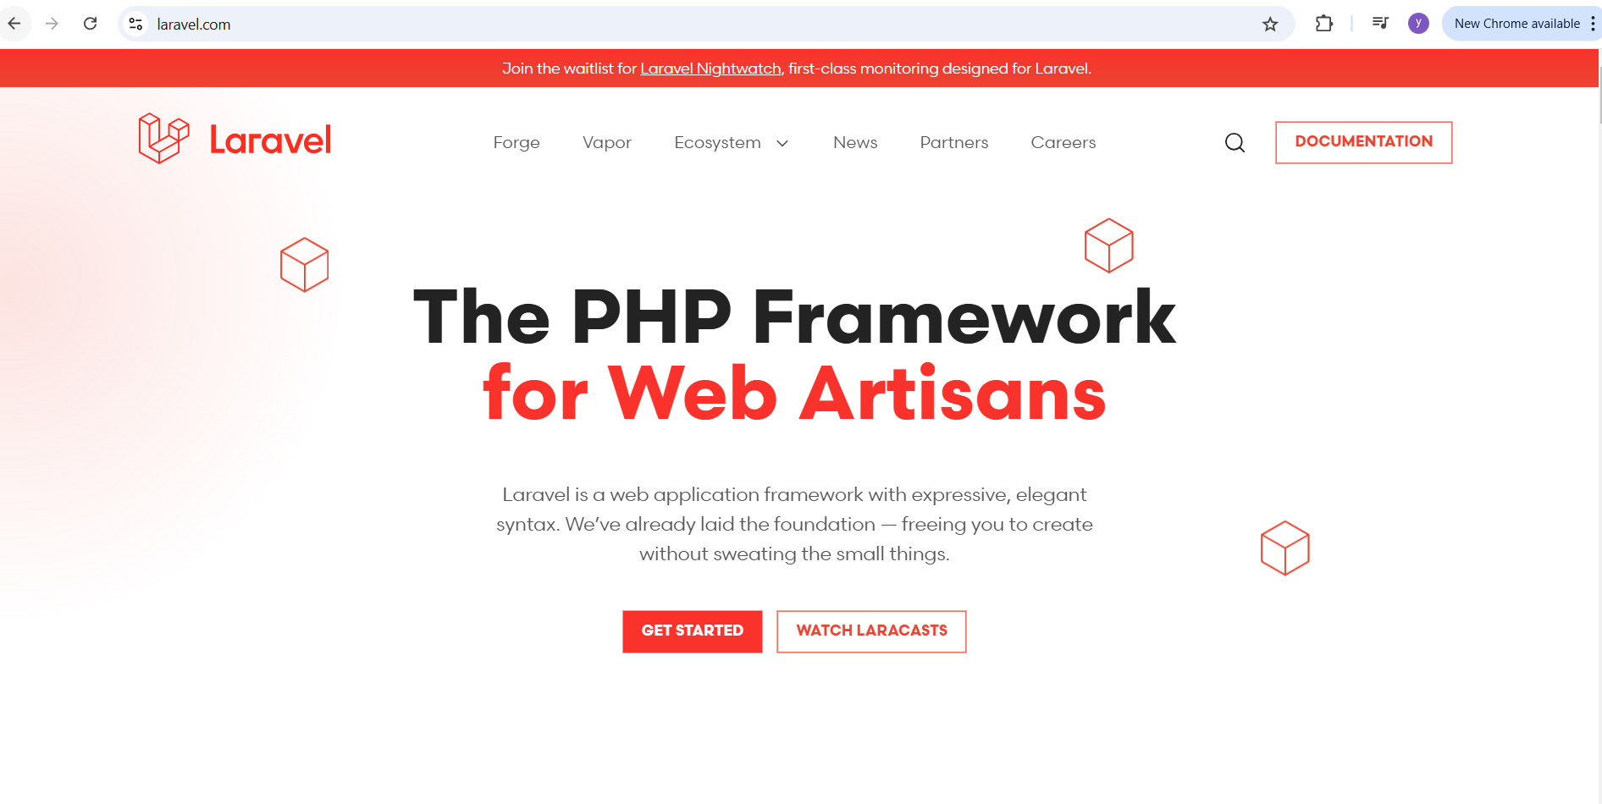
Go to Laravel.com (official site of Laravel)

Slide 20
Command to install Laravel globally
Globally Install the Laravel installer via composer
composer global require laravel/installer
This command has to be run once to install Laravel globally
Installs once → usable everywhere
So you can run:
laravel new projectname
from any folder.

Slide 21
composer
Composer is PHP’s dependency manager 👉 Like npm (Node) or pip (Python)
It installs packages/libraries.

Slide 22
global
This tells Composer:
Install the package globally for the whole system, not inside one project.

Slide 23
require laravel/installer
This means:
Install the Laravel Installer package
It downloads:
laravel/installer
from Packagist (PHP package repository)

Slide 24
C:\Users\<username>\AppData\Roaming\Composer\vendor\bin\laravel
This file gives you the laravel command.

Slide 25
Check Laravel version
laravel -v

Slide 26
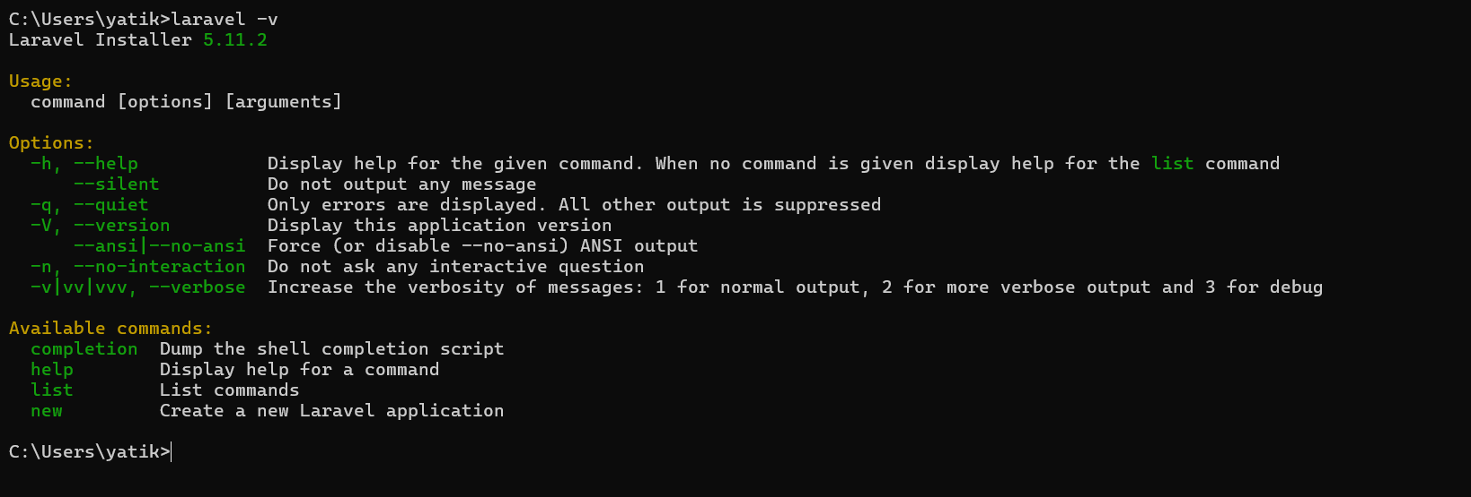
Laravel is installed properly

Slide 27
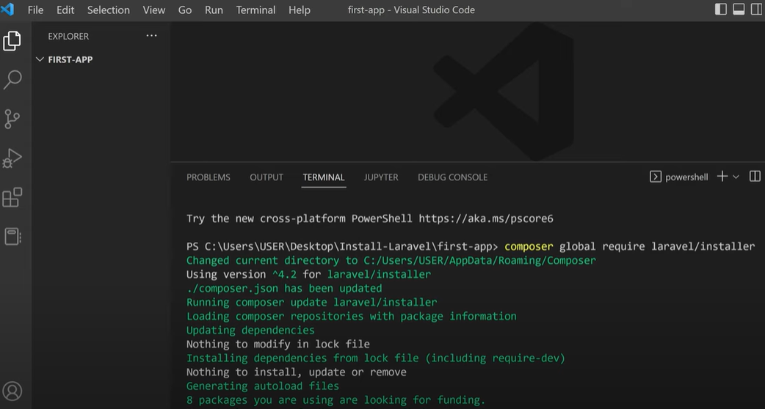
Open the folder in VS Code and run the command (Terminal 🡪 New Terminal)

Slide 28
Issues and solutions- When running the composer global require laravel/installer
Git installation,
modifying the php.ini file,
or environment configuration.

Slide 29
Problem:
Composer requires Git to download dependencies (like laravel/installer) from repositories. If Git is not installed or not properly set up, you'll see errors like:bashCopy code
Failed to clone ... repository not found

Slide 30
Problems Encountered
Need XAMPP Latest Version
composer clear –cache on terminal
Then install composer

Slide 31
Solution:Verify Git Installation:
Run git --version in the terminal to check if Git is installed.
Install Git:On Windows: Download Git from git-scm.com and follow the installation instructions.

Slide 32
Modifying php.ini File
The php.ini file often needs to be updated, which involves removing the semicolon (;) in front of specific lines to enable extensions.
extension=zip
Remove ; from above line

Slide 33
Open SSL Error
The Composer installer script was not successful [exit code 1].
OpenSSL failed with a 'certificate verify failed' error. This indicates a problem with the Certificate Authority file(s) on your system, which may be out of date.
Certificate location [from openssl.cafile ini setting]:
C:\xampp\apache\bin\curl-ca-bundle.crt
The php.ini used by your command-line PHP is: C:\xampp\php\php.ini
Script Output:
The "https://getcomposer.org/versions" file could not be downloaded: SSL operation failed with code 1. OpenSSL Error messages:
error:1416F086:SSL routines:tls_process_server_certificate:certificate verify failed
Failed to enable crypto

Slide 34
Step 1 — Download latest CA certificate
https://curl.se/ca/cacert.pem

Slide 35
Move It To
C:\xampp\php\extras\ssl\cacert.pem

Slide 36
Step 2 — Edit php.ini
C:\xampp\php\php.ini
Find
;curl.cainfo =
;openssl.cafile=

Slide 37
Uncomment and set:
curl.cainfo="C:\xampp\php\extras\ssl\cacert.pem"
openssl.cafile="C:\xampp\php\extras\ssl\cacert.pem"
remove ;
use double quotes
use full path

Slide 38
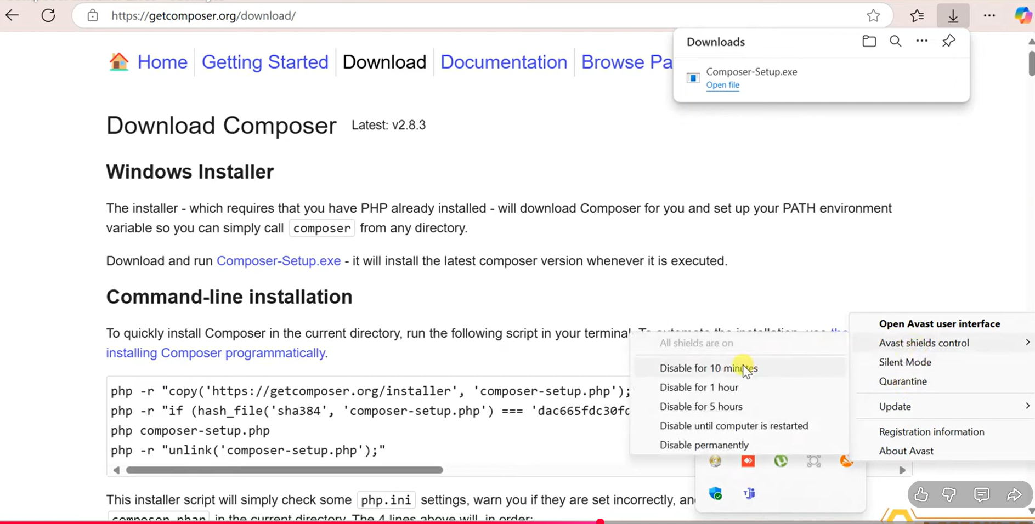
Disable Avast (Disable ) if other things don’t work

Slide 39
How to Create new Project in Laravel
laravel new my_first_app
So it’s just a faster + cleaner command.
Or
2. composer create project Laravel/Laravel project-name

Slide 40
php artisan serve
Go to your first app
cd my_first_app

Slide 41
php artisan serve
The artisan serve command in Laravel is a way to start a built-in PHP development server for your Laravel project.
This command is commonly used during local development to quickly serve your application without needing to set up a full web server like Apache.

Slide 42
php artisan serve
Starts a local development server at http://127.0.0.1:8000 by default.
It allows developers to test their Laravel application locally in a browser.

Slide 43
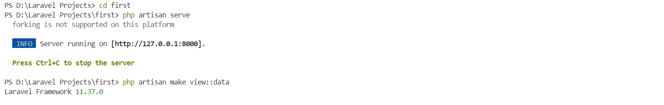
php artisan serve

Slide 44
Default Port Number
8000

Slide 45
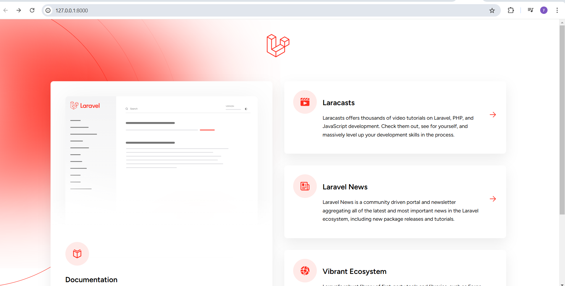
Laravel Home Page

Slide 46
Artisan
Command line interface used in Laravel is called Artisan.
It includes a set of commands which assists in building a web application.
Artisan is Laravel’s command-line interface (CLI) that provides powerful commands for automating tasks like database migrations, model generation, route listing, and caching.
It helps developers save time by reducing manual work.

Slide 47
php artisan list
Displaying All Artisan Commands To view a list of all available artisan commands
To see all available Artisan commands, run:
php artisan list

Slide 48
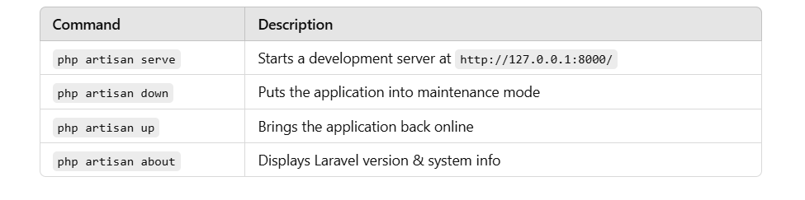
A. Application Management

Slide 49
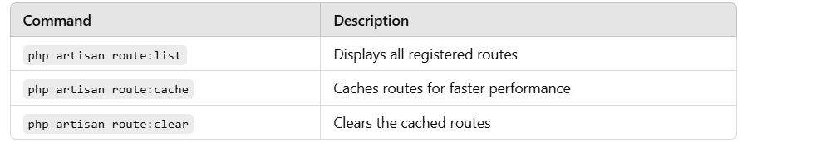
B. Route Management

Slide 50
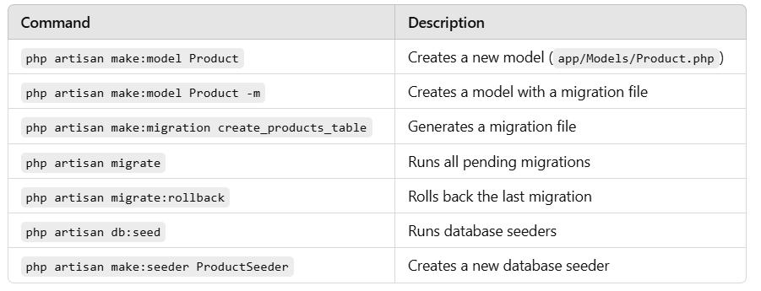
C. Model & Database Commands

Slide 51
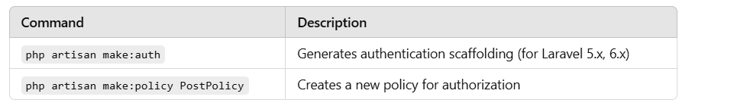
D. Authentication & Authorization

Slide 52
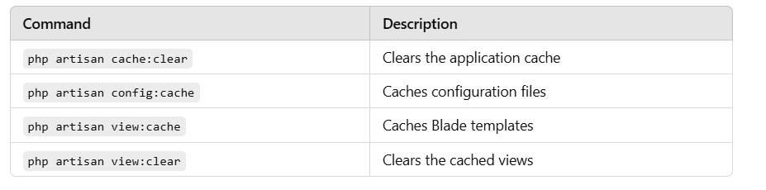
E. Caching & Performance Optimization

Slide 53
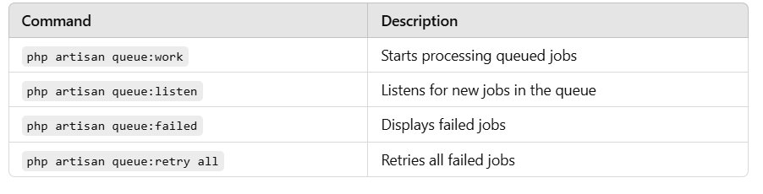
F. Queues & Jobs

Slide 54
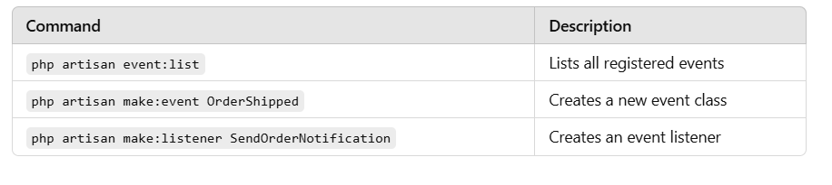
G. Event & Listener Commands

Slide 55
Route::get('/hello', function () {
// return "hey there, this is my first route<br>";
$name= "Amit";
return "The name of student is $name";
});

Slide 56
Route::get('/add/{num1}/{num2}',function ($num1, $num2){
return "The addition of $num1 and $num2 is ".$num1 +$num2;
});

Slide 57
Route::get('/add/{num1}/{num2}',function ($num1, $num2){
return "The addition of $num1 and $num2 is ".$num1 +$num2;
})->where('num1','[0-9]+');

Slide 58
Route::get('first', function(){
return view ('first',['name'=>"Yatika"]);
});

